Slide 1
CSCI E-92 Term Project
Anna Levin
12-18-2018

Slide 2
Overview
Project Goals
Setup
Memory
File system
PCB
Clocks
Interrupts & priorities
Stack setup
Shell Interactions
Additional features
Demo

Slide 3
Project Goals
The problem: lack of security
Data can be read and/or manipulated by third party
No tracking of who uses system and how they use it
The solutions
Event/security logging: who, what, and when
User accounts with
Login username + password
Group identifier
File permissions (read, write, execute)

Slide 4
Setup of Key Data Structures
Memory
Two dynamic double linked lists
Free Memory
Ordered by size
Adjacent spaces are merged togeather before insertion
Allocated Memory
Ordered by address
PCB
Dynamic, circular, double linked list
Info:
Process ID
State
Stack pointer/address/size
Clock time in millis (start, end, and total cpu)
Stream table
Security log ID

Slide 5
Setup (cont.)
File
System wide Inode table
User info
Proccess ID
Typed
Size
Permissions
Data blocks
Stream table per PCB
Device type
File name
Access mode
Position in data blocks
Inode index
Dynamically allocated tables

Slide 6
Clock Usage
Flex Timer
Systick
Oscillator

Slide 7
Interrups & Priority levels
PDB (4)
Flex Timer (5)
UART2 (6)
Systick/PendSV (14)
SVC (15)

Slide 8
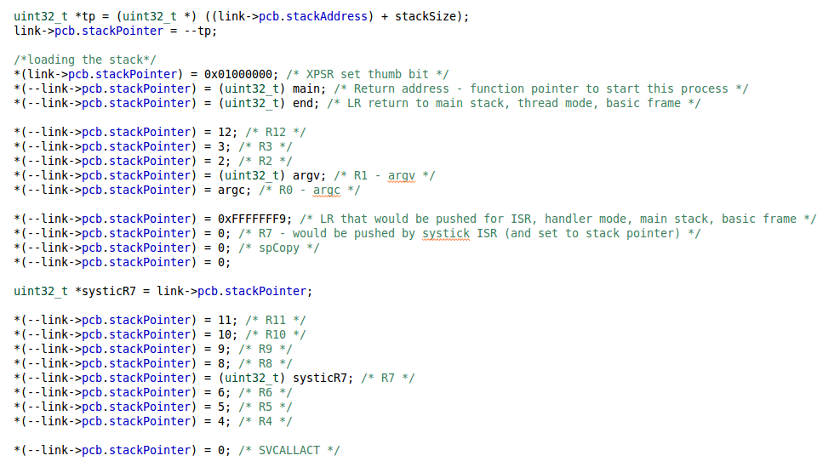
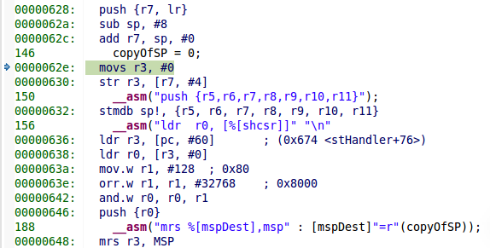
Stack Set-up

Slide 9
Shell starts up
Shell prompts for
login
No
Logout
cmd
No
Execute
command
Log event
Valid
credentials
given
Yes
Yes
valid
command
given
Yes
No
exit
command
given
Log event
No
Get command
Yes
Terminate

Slide 10
Get Command
exit
logout
Admin Commands (e.g., adduser,
logread, spawn )
File Access
Command (e.g., fopen,
delete, purge)
Stream Access
Command (e.g.,
fputc, fgetc, rewind)
Misc. (e.g., help, echo)
Terminate
Log event
is ADMIN
Has correct
permissions
Execute
Yes
Yes
Go to login
Yes
In correct
mode
No
No
Execute
No
Write to security log

Slide 11
Additional Features/Commands
Problem set:
Features:
Escape characters
Strings
Directory hierarchy
Commands:
set/unset
ls
Term project:
Commands:
fputs/fgets
adduser/remuser
logout
purge
logrewind/logpurge/logread
spawnFlashGB/killFlashGB
spawn

Slide 12
DEMO

Slide 13
Questions?

